Slide 1

WomenTechWomenYes
Canvassing Strategy
By Abishek Gollapudi, Zoey Herm, and Max Staley

Slide 2
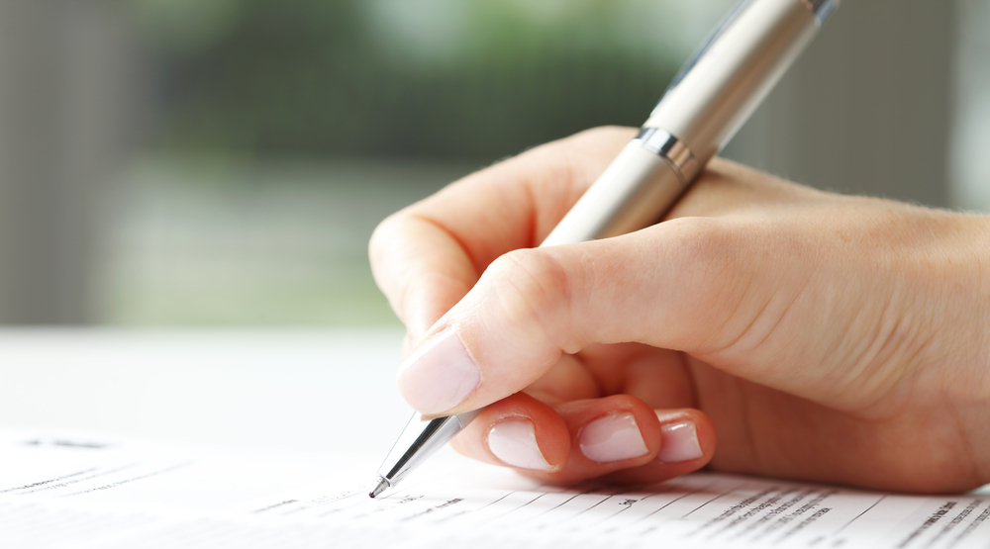

Project Overview
Background
WTWY annual summer gala is coming up!
Deliverable
Suggest subway stations to canvas and gather emails
Ideal Target
Email signup will convert to attendance or donation
Interfaces with women in tech
Already passionate
Might be passionate once exposed to WTYS!
Notes:
Max: VERY QUICKLY, the gala is coming up, you are sending out a street team to gather emails that will convert to gala attendance and future donations, we want to use MTA data to help you optimize and be efficient with your resources: we want the street teams to encounter a lot of tech employees in absolute as well as relative terms

Slide 3



Methodology
Stations that service primarily commuters
Stations near tech hubs
Commuter Stations
Source: MTA data (May 2018)
Criteria:
High weekday:weekend ratio
High rush hour:mid-day ratio
Tech Hub Stations
Source: NYC open data
Criteria: Sample of 500 tech companies
High signup-to-engagement conversion
Technology platforms used:
Notes:
Our assumption was that canvassers would be most successful at stations where they would encounter the most tech workers.
We first identified the highest-volume stations in NY’s subway system (data from May 2018 — we could add more data, but it’s unlikely to significantly change our recommendations.) Unsurprisingly, these were in Midtown and the Financial District.
Then we used two metrics to “qualify the leads”: weekday to weekend ratio, and rush-hour to midday ratio (we will explain this further shortly)
Finally — and this is the really exciting part — we/Abi used NYC open data to map candidate stations and tech employers to identify the stations that tech workers are most likely to use on their commutes
One thing our approach is missing is demographic data that could be used to optimize conversion rates (income, gender, values).

Slide 4
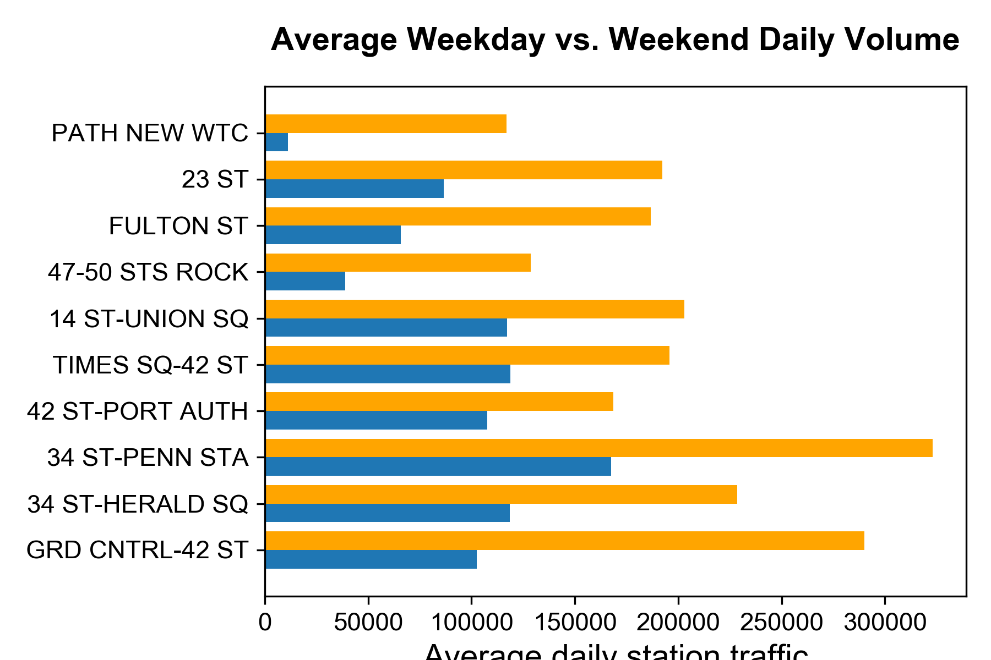
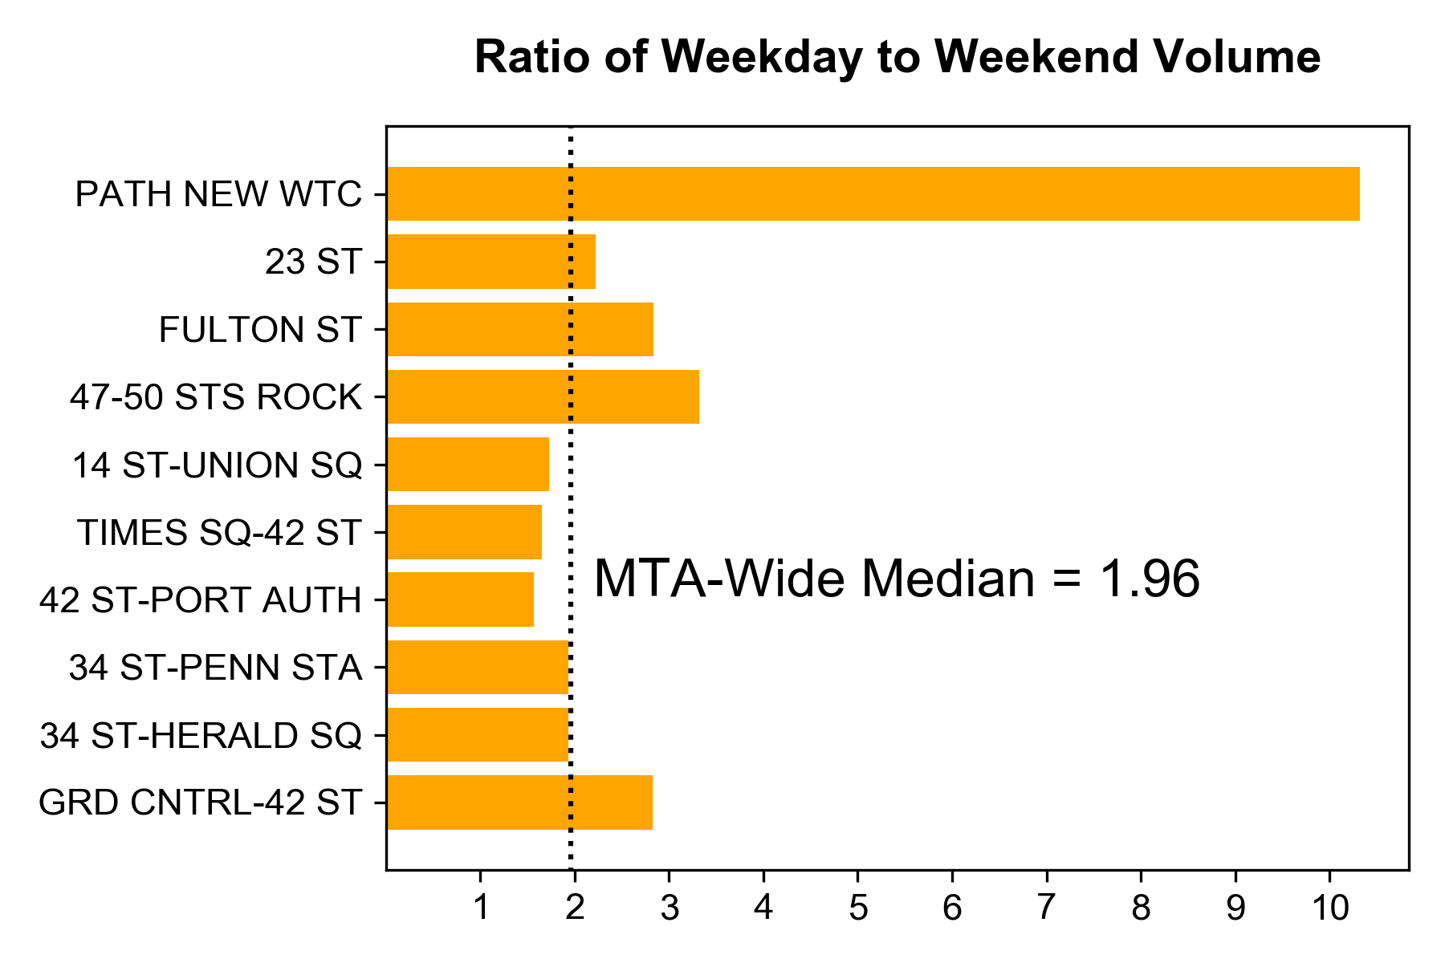
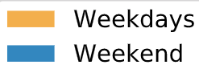
Weekday vs. Weekend Usage
Average daily station traffic
Ratio
Stations with relatively higher weekday volumes have relatively more commuters, as opposed to tourists and local residents.
Notes:
People ride the subway less on the weekend, but the difference varies among stations.
There are two ways of looking at it: comparing the daily average volume (entries and exits) directly or the ratio of the averages.
The ratio is probably best for disqualifying stations: places like Times Square, Union Square etc. might have a lot of volume, but it seems like there’s lots of tourists there. On the other hand, the financial district has stations like WTC and Fulton where there are lots of commuters (based on this metric)

Slide 5
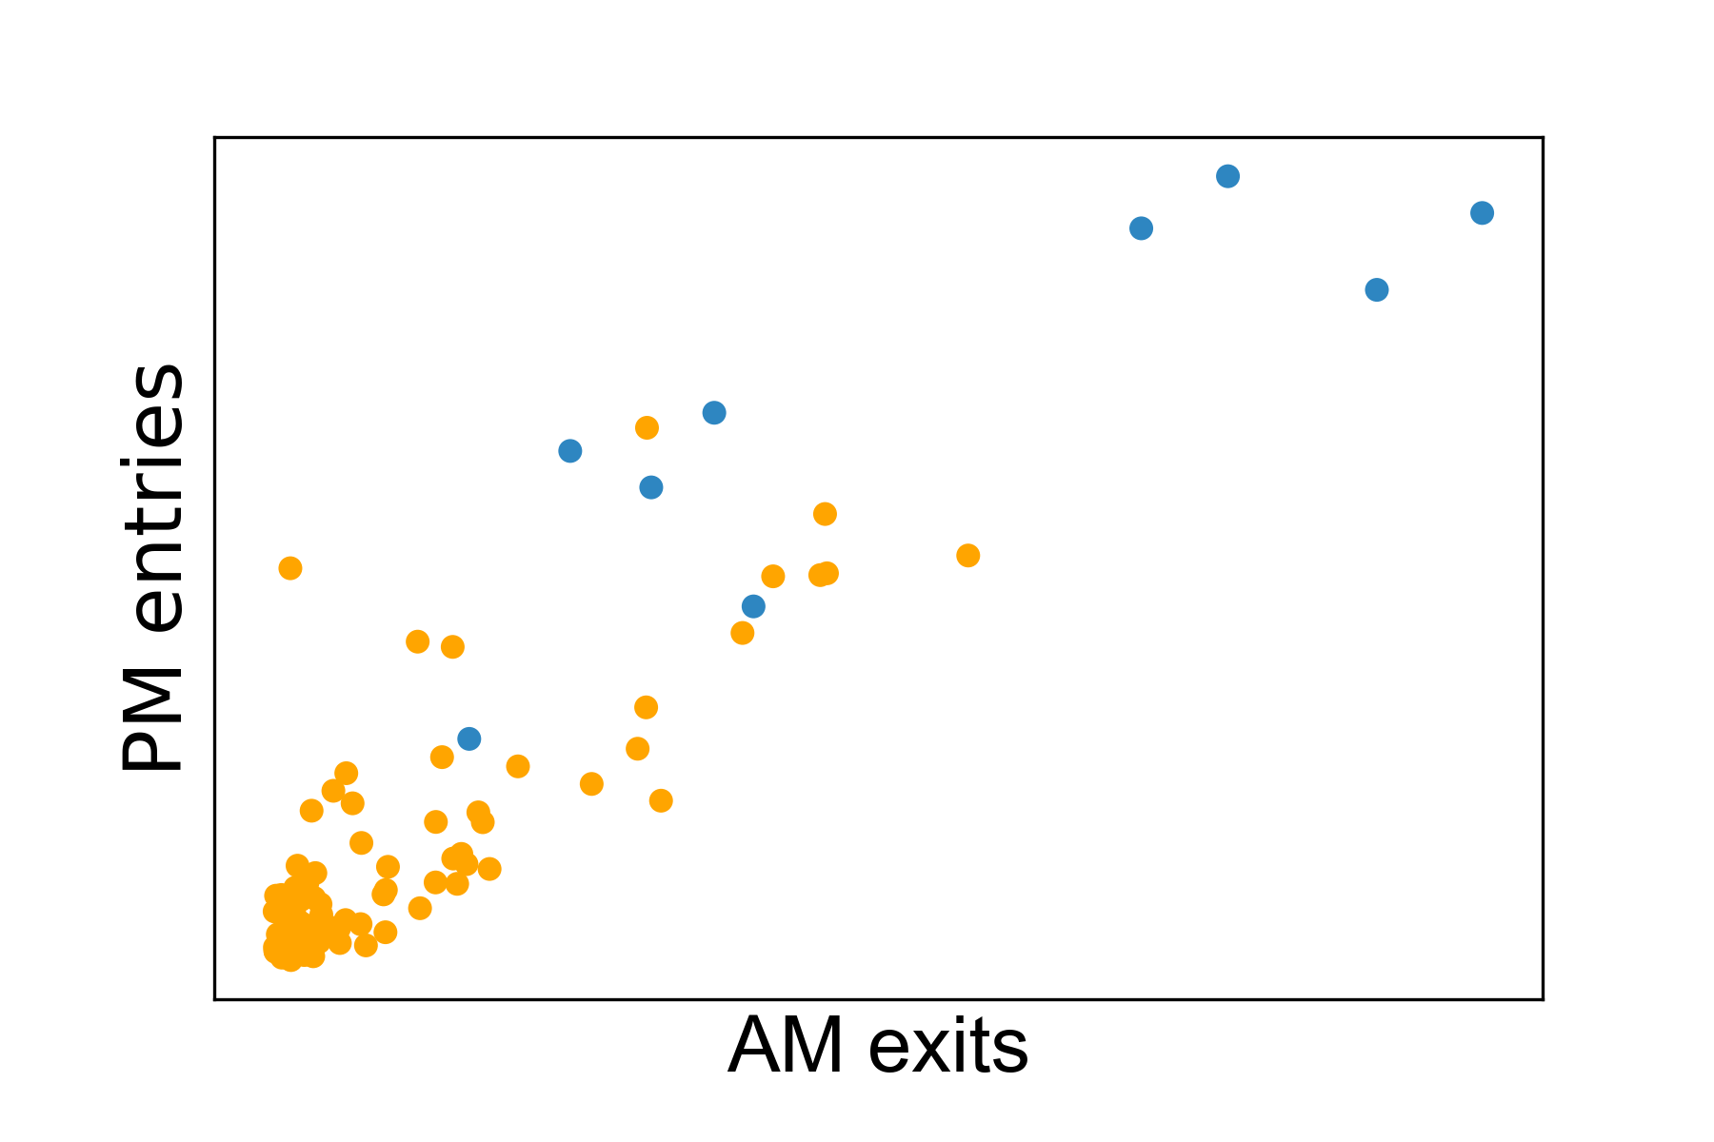
Rush Hour: Morning Exits, Evening Entries
Commuter station: Busy during rush hour vs. other times
Many entries in the evening to go home
Many exits in the morning to go to work
Top 10 busiest stations
Remaining stations
PM Entries (relative to mid-day)
AM Exits (relative to mid-day)
Most top 10 busy stations fit the commuter station profile
Notes:
Potential slide to add on to previous slide? This would be optional so we can decide if we want to include this plot in the morning.

Slide 6
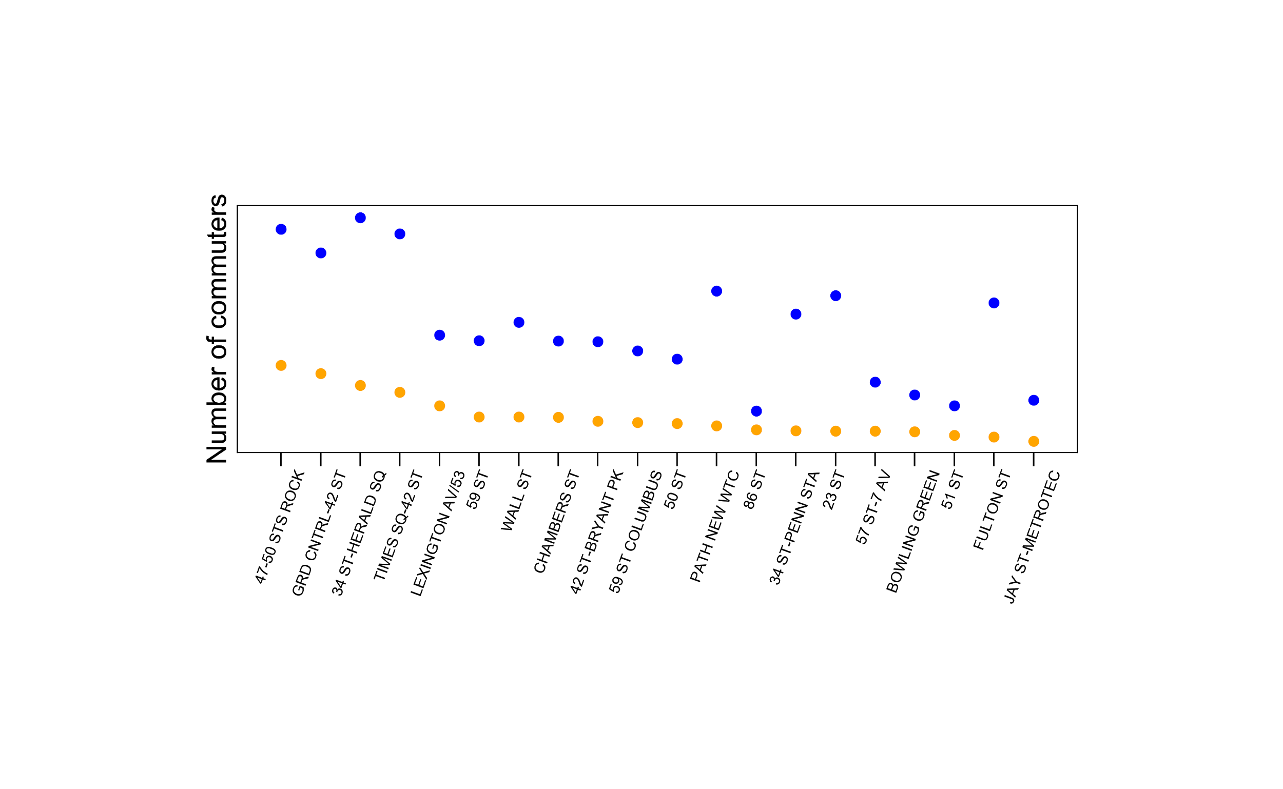
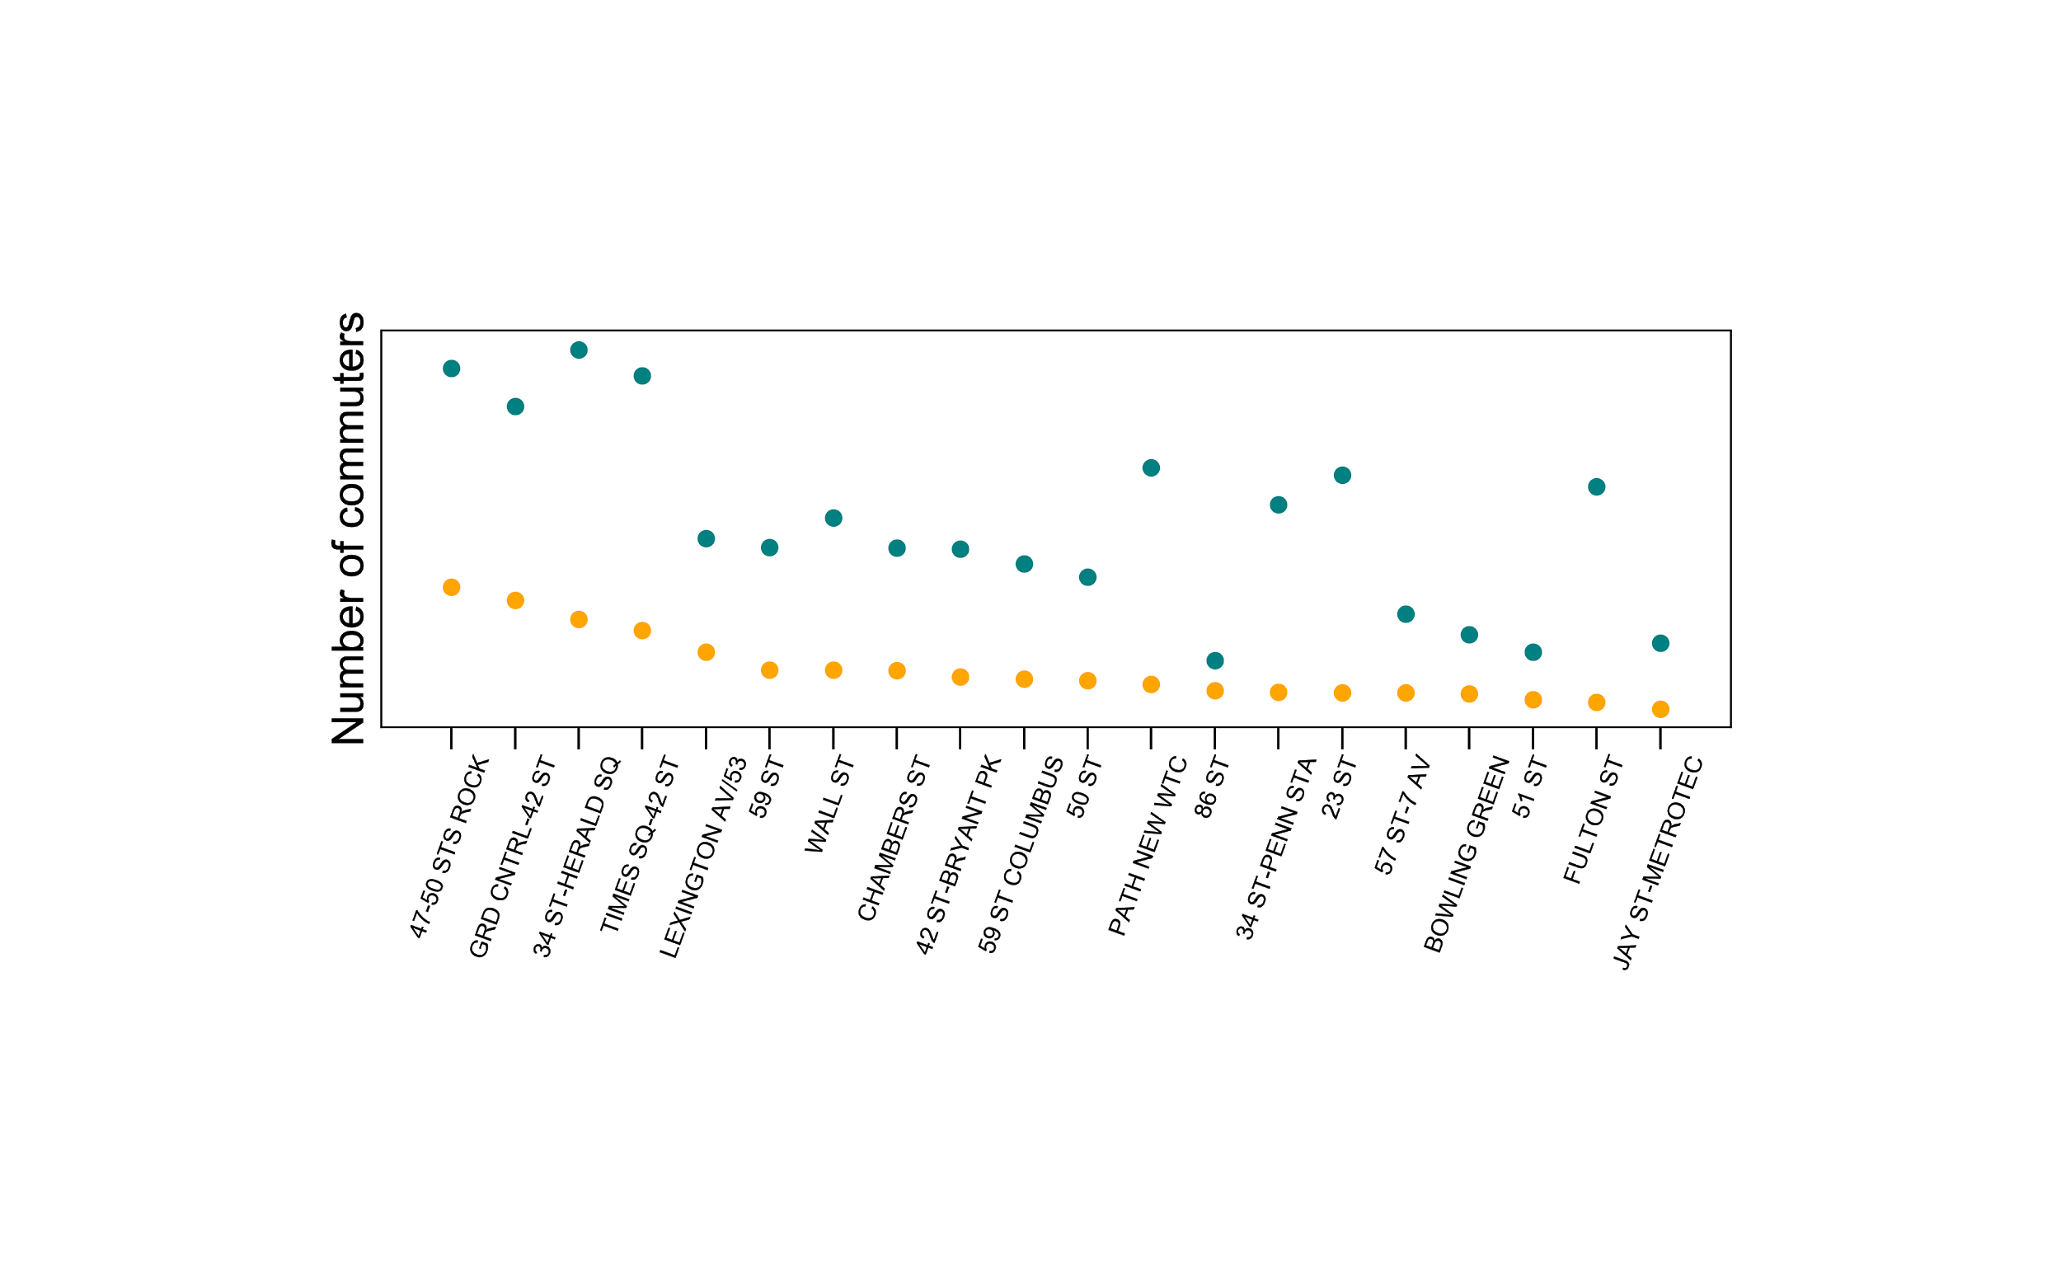
Rush Hour: Morning Exits, Evening Entries
Commuter station: Busy during rush hour vs. other times of day
Many entries in the evening to go home
Many exits in the morning to go to work
Notes:
Zoey

Slide 7
Rush Hour: Morning Exits, Evening Entries
Commuter station: Busy during rush hour vs. other times of day
Many entries in the evening to go home
Many exits in the morning to go to work
Most top 10 busy stations are commuter stations
Notes:
Zoey

Slide 8
Geospatial Data: Proximity to Tech Companies
Notes:
Abi

Slide 9
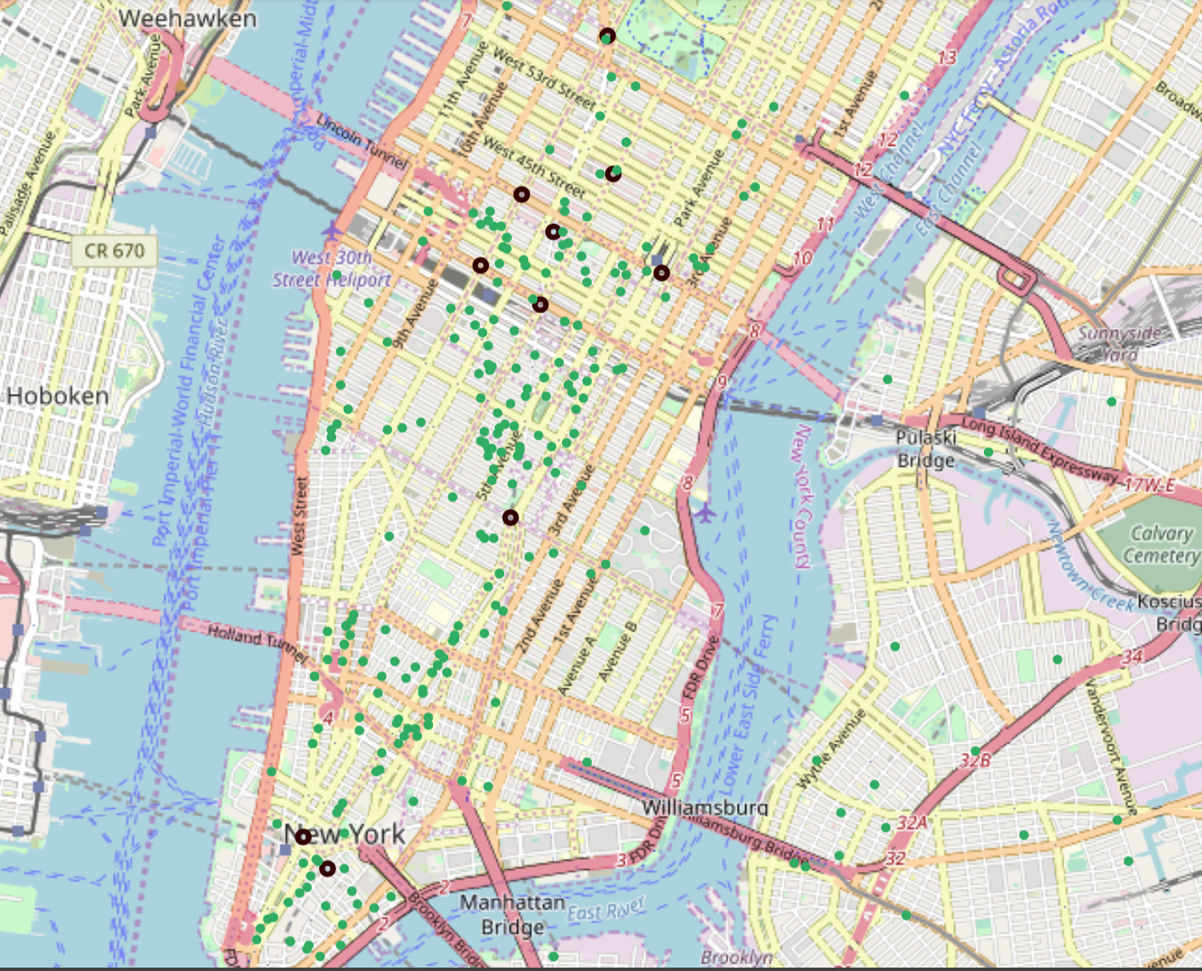
Geospatial Data: Proximity to Tech Companies
Notes:
Abi

Slide 10
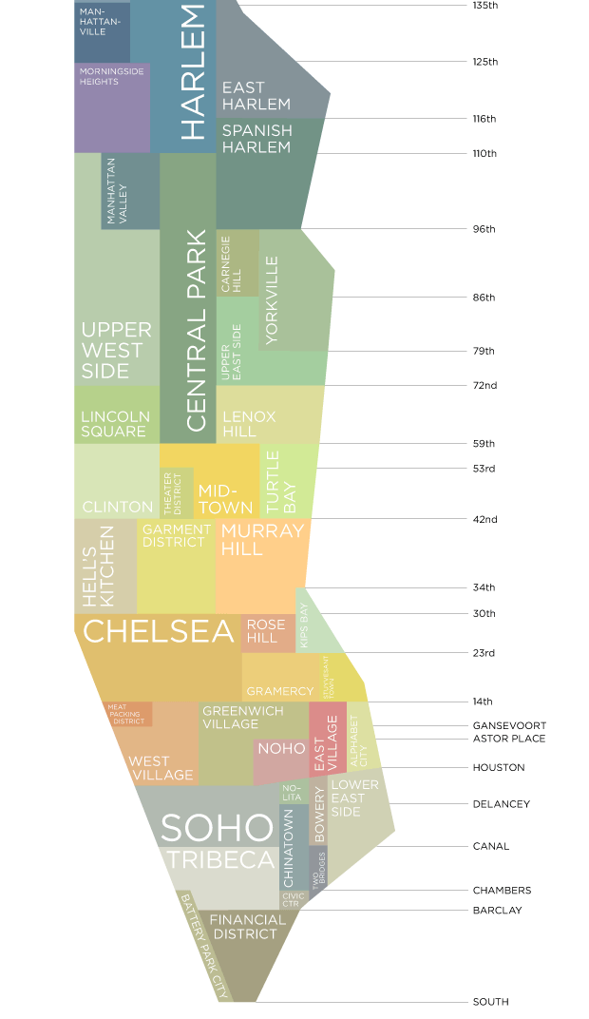
Station Recommendations
Four stations are near tech centers
and fit the commuter station profile
Midtown
Penn Station
Flatiron District
23rd St
Financial District
Fulton St.
World Trade Center
Tech
Commuter Stations
Notes:
Abi: List the Stations
Zoey: Talk about canvassing in the evening
Max: Talk about canvassing in the middle of the week

Slide 11

Opportunities for Further Development
Refine to target high income tech workers
Look at where the commuters are coming from
Incorporate behavioral psychology
Canvas near home or work?
Model optimal granularity of street team deployment
Use size, availability of street team
Incorporate previous years’ conversion rates
Email signups → attendance
Notes:
Zoey

Slide 12
Notes:
Zoey

Slide 13
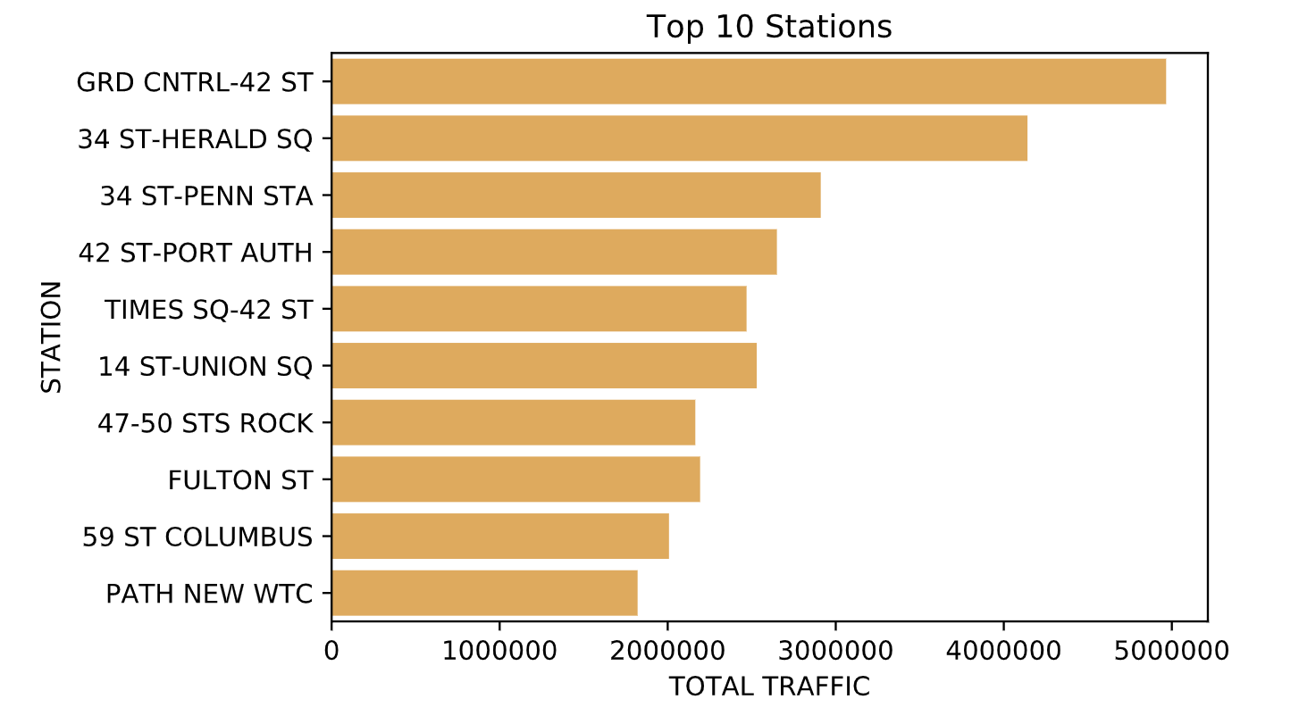
Top 10 Stations by total traffic (24/7)

